Slide 1
IPv6 The Internet’s Future?
Barry O’Donovan
Engineers Ireland - April 25th 2012
https://www.inex.ie/ei-ipv6-2012.html

Slide 2
INEX
An IXP – Ireland’s IP Peering Hub
Neutral, industry owned association
Founded 1996; ~66 members; 5 PoPs

Slide 3
INEX
An IXP – Ireland’s IP Peering Hub
Neutral, industry owned association
Founded 1996; ~66 members; 5 PoPs
https://www.inex.ie/joining/aboutixps
https://www.inex.ie/about/memberlist

Slide 4
Barry O’Donovan
“Internet Infrastructure Specialist”
MD of Open Solutions
“Closet geek; political anorak, husband, father, network enginner, company owner, employer, …”
http://www.barryodonovan.com/
http://www.opensolutions.ie/

Slide 5
Overview
A (brief?) history of Internet numbering
IPv4 exhaustion status
Introduction to IPv6
Why IPv6 adoption is sooooooooooo slow
The IPv6 opportunity

Slide 6
Overview
A (brief?) history of Internet numbering
IPv4 exhaustion status
Introduction to IPv6
Why IPv6 adoption is sooooooooooo slow
The IPv6 opportunity

Slide 7
The Problem
Why IPv6?
Because we’ve run out of addresses
Again!
Huh? Really!?
Yes, we’ve been here before!

Slide 8
Internet Time Machine
1969: ARPANET commissioned by DoD
1970: ARPANET hosts start using NCP:
Network Control Protocol [RFC33]
8 bit addressing
=> only 256 hosts!

Slide 10
Internet Time Machine
1972: Telnet specification [RFC318]
1973: Ethernet outlined in a PhD Thesis
File Transfer specification [RFC454]
1976: Queen Elizabeth sends an email!

Slide 11
Internet Time Machine
1982: DCA & ARPA establish TCP and IP
DoD declares TCP/IP as their standard
1983: Cutover from NCP to TCP/IP (IPv4)
“Flag Day” – January 1st 1983
RFC2235 – Hobbes’Internet Timeline

Slide 12
“Flag Day” January 1st 1983
All nodes updated on Flag Day to IPv4
(still “facepalm”?)
8bit addresses -> 32 bit addresses
~4.29 billion addresses
Enough?
No: 7.008 billion people; 8.01 by 2025
1 billion “smart devices” shipped in 2011

Slide 13
Back Up the Truck
Are we all clear on what an IP address is?
“A number assigned to a device on a network”
We’ve all seen them:
127.0.0.1 192.168.1.254 8.8.4.4
DNS: www.engineersireland.ie => 46.22.128.85

Slide 14
Who’s the Boss?
IANA
RIRs – Regional Internet Registries
AfriNIC
APNIC
ARIN
LACNIC
RIPE
LIRs – Local Internet Registries
Blacknight
Vodafone
eircom
End Users

Slide 15
Overview
A (brief?) history of Internet numbering
IPv4 exhaustion status
Introduction to IPv6
Why IPv6 adoption is sooooooooooo slow
The IPv6 opportunity

Slide 16
What’s Left?
IANA
Feb 3rd 2011
AfriNIC
APNIC
ARIN
LACNIC
RIPE
Apr 15 ‘11

Slide 17
What’s Left?
IANA
Feb 3rd 2011
AfriNIC
APNIC
ARIN
LACNIC
RIPE
Mid 2015
Apr 15 ‘11
Late 2013
Mid 2014
Late 2012
Final /8 policies:
once only - /22 (1024) – must have IPv6
~16k allocations (>7k LIRs in RIPE 2010)

Slide 18
What’s Left?
IPv4 exhaustion projection is a presentation in its own right
If you want to know more:
Geoff Huston - http://www.potaroo.net/
http://www.potaroo.net/tools/ipv4/index.html

Slide 19
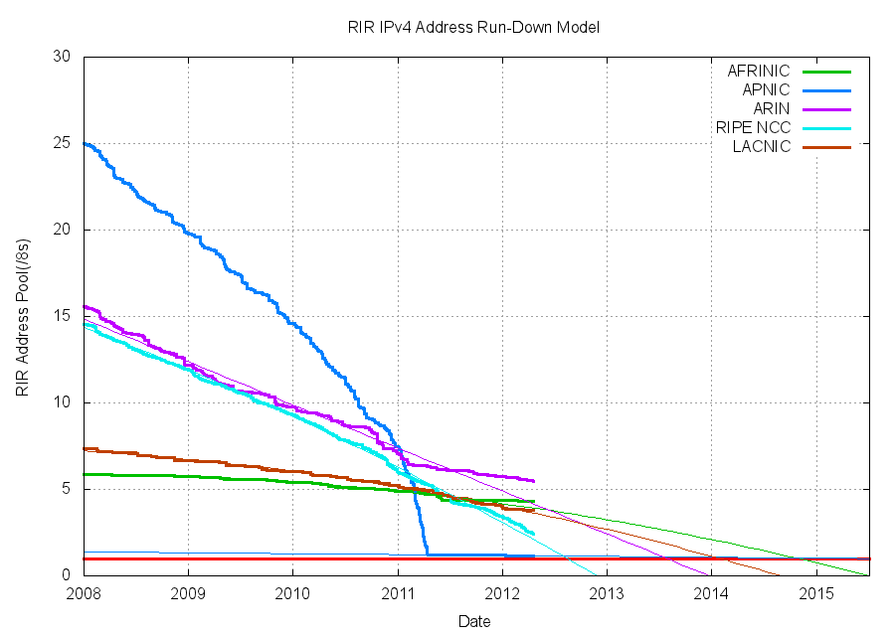
What’s Left?
IPv4 exhaustion projection is a presentation in its own right
If you want to know more:
Geoff Huston - http://www.potaroo.net/
http://www.potaroo.net/tools/ipv4/index.html

Slide 20
Overview
A (brief?) history of Internet numbering
IPv4 exhaustion status
Introduction to IPv6
Why IPv6 adoption is sooooooooooo slow
The IPv6 opportunity

Slide 21
IPv6
IETF began developing IPng in…
1993!
RFC1883 Internet Protocol, V6, Specification
(1995)
IETF Standard 1998 (RFC2460)

Slide 22
IPv6 in the OSI Model?
Application
Application
TCP UDP ICMP
TCP UDP ICMP
IPv4
IPv6
Data Link
Data Link
Physical
Physical

Slide 23
What’s New in IPv6
It’s (only?) an evolution of IPv4
Extended address space
32bit addresses => 128bit addresses
~4.29 billion => ~340 undecillion
Huh?
340,282,366,920,938,000,000,000,000,000,000,000,000

Slide 24
What’s New in IPv6
Stateless autoconfiguration (and RD)
Simplified header
Removed on-the-fly fragmentation
No more ARP – Now ICMPv6 ND
Native Security, Flow labels & IPsec

Slide 25
IPv6 Addressing
128 bits / 16 bytes: 8 x 16bit hex blocks
2001:0db8:0000:0000:0702:b33f:001b:0055
2001:0db8::0702:b33f:001b:0055
2001:db8::702:b33f:1b:55
2a01:268:3002::35

Slide 26
IPv6 Subnetting
340 undecillion addresses is a bit misleading…
2001:0db8
Typical initial LIR allocation is /32.

Slide 27
IPv6 Subnetting
340 undecillion addresses is a bit misleading…
2001:0db8:0000:0000:0702:b33f:001b:0055
64 bit interface ID
18,446,744,073,709,551,616 addresses – 18.4 “quintillion”.
ISP end user assignment /48 (/56)
65,536 /64 subnets at end user.
Typical initial LIR allocation is /32. 65,536 /48 end users / sites

Slide 28
IPv6 in the “Real World”
It’s been around and live for a long time!
“If the end user ever needs to know about IPv6 then we’ve made a complete f&%k up of the transition.”
All current operating systems support it. Natively and by default.
Even Windows!

Slide 29
IPv6 in the “Real World”
It’s been around and live for a long time!
“If the end user ever needs to know about IPv6 then we’ve made a complete f&%k up of the transition.”
All current operating systems support it. Natively and by default.
Even Windows!

Slide 30
IPv6 in the “Real World”
Most services have long supported IPv6
SMTP, POP3, IMAP, DNS, HTTP(s), SSH, Telnet, FTP, Bit Torrent, IRC, IM, …
Modern systems default to IPv6
(e.g. DNS AAAA lookups before A)

Slide 31
IPv6 in the “Real World”
barryo@destiny:~ $ host www.opensolutions.ie
www.opensolutions.ie has address 87.232.16.35
www.opensolutions.ie has IPv6 address 2a01:268:3002::35
barryo@destiny:~ $ host -t MX opensolutions.ie
opensolutions.ie mail is handled by 10 mail.opensolutions.ie.
barryo@destiny:~ $ host mail.opensolutions.ie
mail.opensolutions.ie has address 87.232.16.61
mail.opensolutions.ie has IPv6 address 2a01:268:3002::61
So what’s the problem…?

Slide 32
Overview
A (brief?) history of Internet numbering
IPv4 exhaustion status
Introduction to IPv6
Why IPv6 adoption is sooooooooooo slow
The IPv6 opportunity

Slide 33
Transition to IPv6
IPv6 is not backwards compatible with IPv4
A second “Flag Day” is impossible
That leaves two real choices:
(a) Dual stack networking (medium term)
(b) CGNs, CDNs, ALGs (medium -> long term)

Slide 34
Dual Stack Transition
Running IPv4 and IPv6 in parallel
Already in place for modern OS’
Already in place for modern (ISP) routers
Firewalls & L7 Devices Caught/Catching Up
Main issues are: access network and CPEs
And demand.
And we still have IPv4.

Slide 35
Back Up the Truck. Again.
We should probably talk about
ISP networking

Slide 36
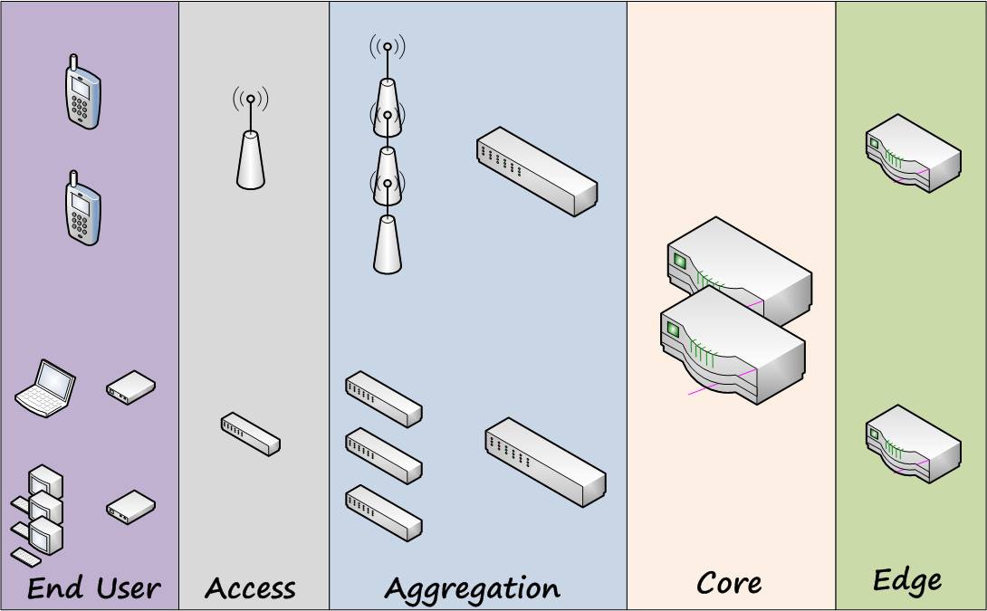
Back Up the Truck. Again.
We should probably talk about
ISP networking

Slide 37
Back Up the Truck. Again.
We should probably talk about
ISP networking
And
“The Internet”

Slide 38
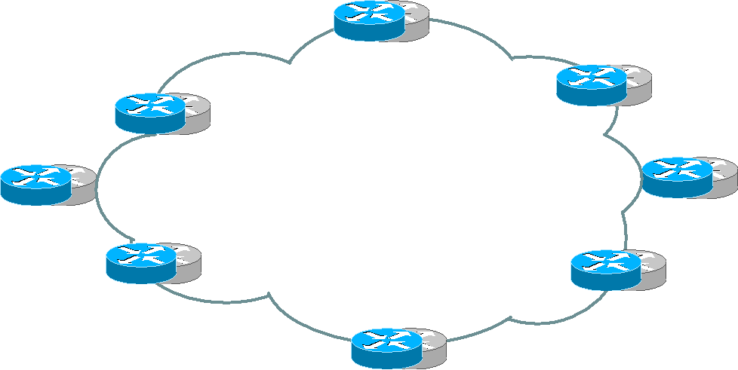
Back Up the Truck. Again.
We should probably talk about
ISP networking
And
“The Internet”
Transit Providers
Our ISP
Content

Slide 39
Back Up the Truck. Again.
We should probably talk about
ISP networking
And
“The Internet”
Our ISP
Content

Slide 40
Back Up the Truck. Again.
We should probably talk about
ISP networking
And
“The Internet”
Our ISP
Content

Slide 41
Back Up the Truck. Again.
We should probably talk about
ISP networking
And
“The Internet”
Our ISP
Content

Slide 42
Dual Stack Transition
We said:
“Main issues are: access network and CPEs”
From what we just learned,
where are we with IPv6 transition?

Slide 43
Back Up the Truck. Again.
We should probably talk about
ISP networking

Slide 44
Dual Stack Transition
We said:
“Main issues are: access network and CPEs”
From what we just learned,
where are we with IPv6 transition?
Transit Providers
Our ISP
Content

Slide 45
Transition to IPv6
Next issue: Demand.
End user demand – have you asked your ISP?
Your IT vendors? RFTs?
Access Provider ⬄ Content Provider
Need IPv6 content that users demand
Need IPv6 users that content providers need

Slide 46
Transition to IPv6
Next issue: Demand.
End user demand – have you asked your ISP?
Access Provider ⬄ Content Provider
Need IPv6 content that users demand access to
Need IPv6 users that content providers need to reach

Slide 47
Transition to IPv6
How do we solve “chicken and egg” problem?
It’s actually quite easy…
But painful… and slow…
We wait.
IPv4 is running out. Fast.
We need to aggressively push / demand IPv6
We need to avoid CGNs / CDNs / ALGs

Slide 48
Irish ISPs and IPv6 Ripeness
RIPE have an IPv6 RIPEness project
Up to 4 stars assigned for:
Having an IPv6 allocation
Visibility in routing tables
Having a “route6” object
Having a reverse DNS delegation
http://ripeness.ripe.net/

Slide 49
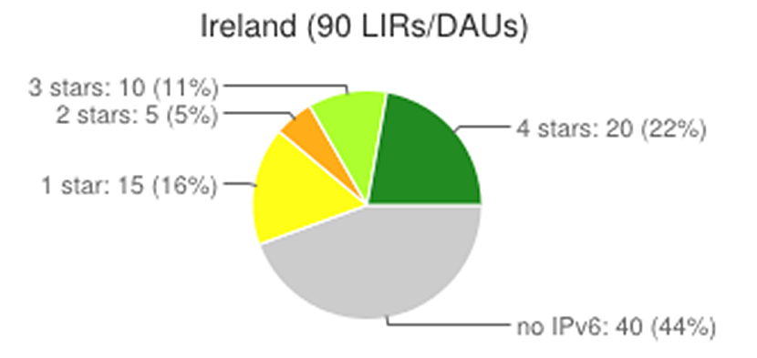
Irish ISPs and IPv6 Ripeness

Slide 50
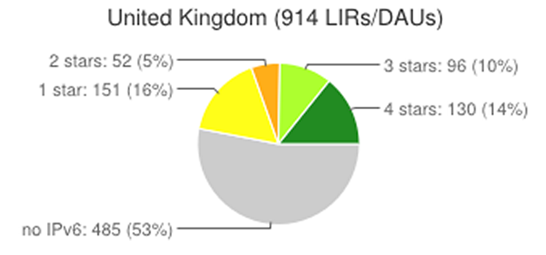
Irish ISPs and IPv6 Ripeness

Slide 51
Irish ISPs – Top Performers

Slide 52
World IPv6 Day – June 8 ‘11
Top websites & ISPs turned on IPv6
Google, Facebook, Yahoo!, Akamai, Limelight
“To see what would happen…”
Microsoft (and xbox, bing); 100+ million users
“Almost no connectivity issues”
“Brokenness was within the margin of error”

Slide 53
World IPv6 Launch – June 6 ‘12
Permanently enabling IPv6
Google, Facebook, Yahoo!, Akamai, Limelight
Microsoft, AT&T, D-Link, Cisco

Slide 54
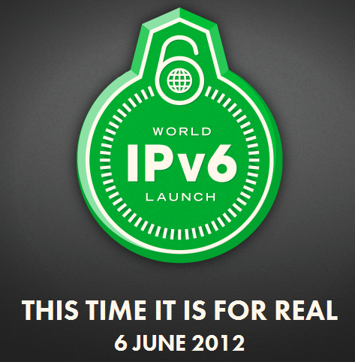
World IPv6 Launch – June 6 ‘12
Permanently enabling IPv6
Google, Facebook, Yahoo!, Akamai, Limelight
Microsoft, AT&T, D-Link, Cisco

Slide 55
Overview
A (brief?) history of Internet numbering
IPv4 exhaustion status
Introduction to IPv6
Why IPv6 adoption is sooooooooooo slow
The IPv6 opportunity

Slide 56
The IPv6 Opportunity
IPv6
“The Powerhouse of the Internet’s Future”
Hmmm…
Well certainly enabling the Internet’s future
We’re all aware of the benefits of the Internet
But what advantages does IPv6 offer?

Slide 57
The IPv6 Opportunity
More address space.
Auto-configuration (local and routable).
Return to end-to-end networks. Woot!
i.e. no more NAT!
“An Internet of Devices”
IPv6 is built to scale – no manual intervention

Slide 58
The IPv6 Opportunity
Network merges – renumbering (and VPNs)
More efficient routing
More efficient packet processing
Directed Data Flows & Multicast

Slide 59
The IPv6 Opportunity
To sum it up:
IPv6 is about the future;
And future possibilities.

Slide 60
Overview
A (brief?) history of Internet numbering
IPv4 exhaustion status
Introduction to IPv6
Why IPv6 adoption is sooooooooooo slow
The IPv6 opportunity
Getting starting with IPv6

Slide 61
Getting Started with IPv6
Ask your ISP for IPv6
They’ll probably say no. Do it anyway!
Then goto a “tunnel broker”
SixXS: http://www.sixxs.net/
Hurricane Electric: http://www.tunnelbroker.net/
6to4 - 6rd - Teredo

Slide 62
That’s All Folks!
Copy of the Presentation:
https://www.inex.ie/ei-ipv6-2012.html
Contact me:
Barry O’Donovan
barry@opensolutions.ie
INEX: https://www.inex.ie/

